Slide 1
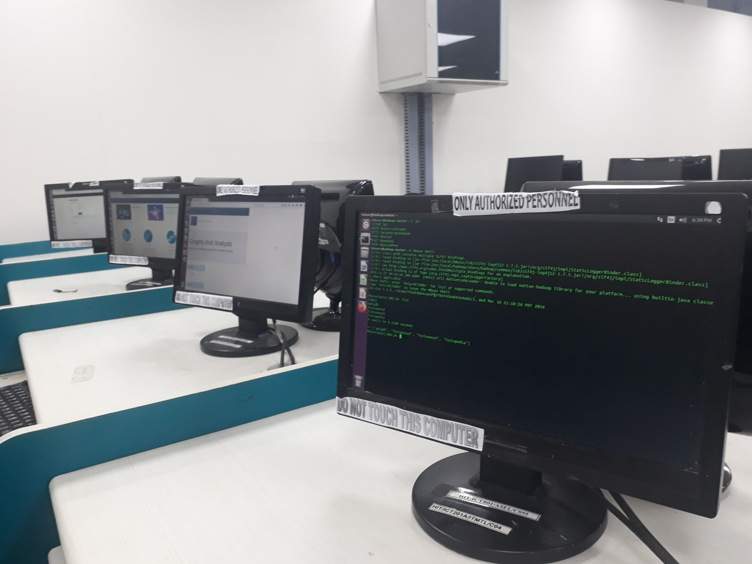

FUSIONASA: Integrated multiomics distributed database for analysis of cancer genomes
Made By:
Name of Student: Soumita Ghosh (1654062)
Ayush Prasad(1654040)
Anirban Mahapatra (1654069)
Mentor: Prof. Rituparna Samaddar (Sinha)

Slide 2
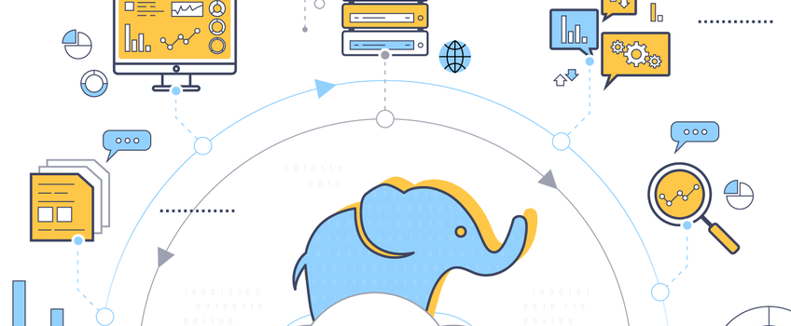
BigData
Introduction to BigData with Hadoop and Hbase

Slide 3
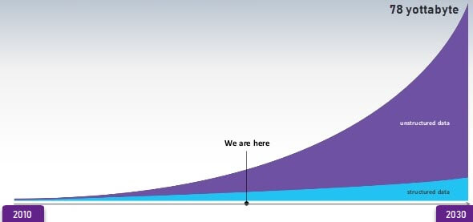


What Is BIG-DATA ?
Data which are very large in size is called Big Data. Normally we work on data of size MB or maximum GB but data in Peta bytes i.e. 10^15 byte size is called Big Data.
Big Data describes data sets so large and complex they are impractical to manage with traditional software tools.

Slide 4

Category of BIG-DATA
Structured data Unstructured Data

Slide 5
Issues In Bigger Data
The amount of data we generate cannot be stored or processed in an efficient way.
The more data you need to store, the more complex these problems will become.
What works cleanly for a small volume of data may not work the same for bigger demands.
So How To Overcome This Problem???

Slide 6

Hadoop
Advantages :
Hadoop framework takes care of distributing and splitting the data across all the nodes within a cluster.
It supports parallel processing of data. This saves a lot of time.
Offers a huge computing power and a huge storage system to the clients.
Hadoop uses HDFS to store data and MapReduce to process the data

Slide 7
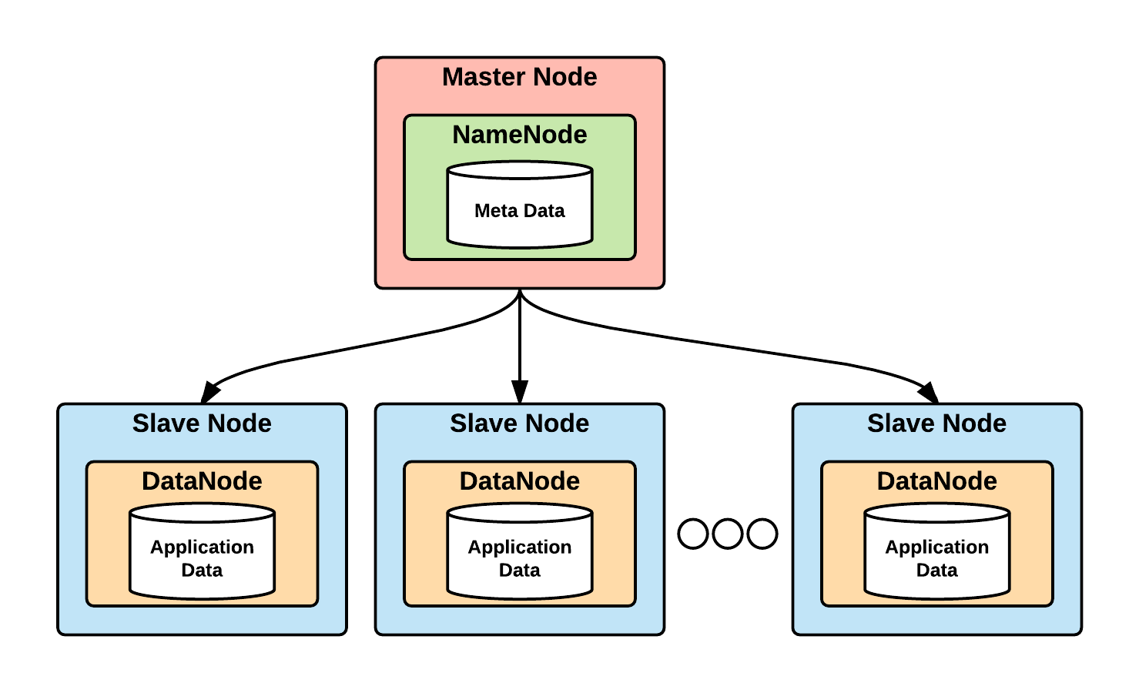
HDFS :
The Hadoop Distributed File System (HDFS) is designed to store very large data sets.
In a large cluster, thousands of servers both host directly attached storage and execute user application tasks.

Slide 8
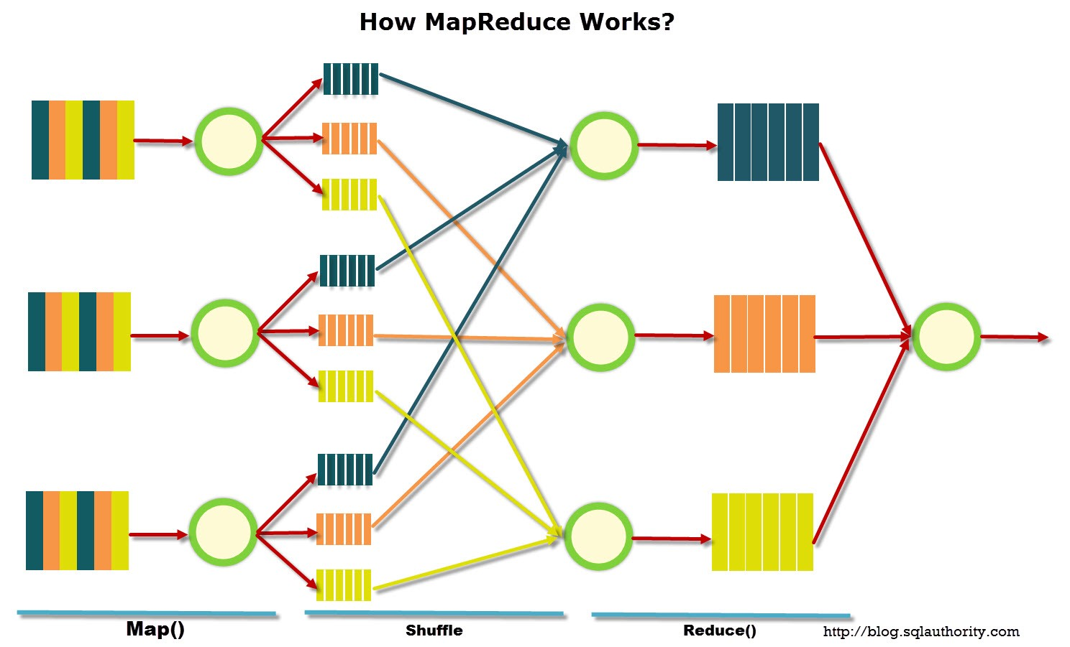
Map Reduce
Hadoop Map/Reduce is a software framework for distributed processing of large data sets on computing clusters.
Mapreduce helps to split the input data set into a number of parts and run a program on all data parts parallel at once.

Slide 9
Problem With Hadoop
Hadoop uses batch processing so read/write/access very large tables.
It doesn't provide random access to data across the tables.
So what is the solution ?

Slide 10
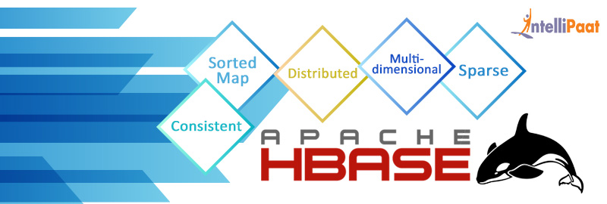
Hbase
HBase is a column-oriented database management system that runs on top of Hadoop Distributed File System (HDFS).

Slide 11
Features :
HBase is an open-source,writtten in JAVA.
HBase is non-relational distributed database modelled after Google's Bigtable.
Hbase is linearly scalable. (due to column family) and offers data replication across clusters.
Rowid | Column Family |  |  | Column Family |  |  | Column Family |  |  | Column Family
 | col1 | col2 | col3 | col1 | col2 | col3 | col1 | col2 | col3 | col1 | col2 | col3
1
2
3

Slide 12
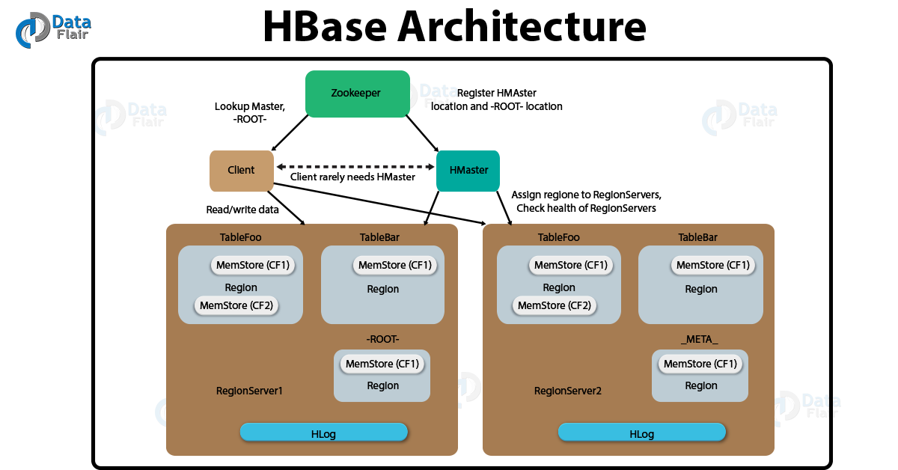

Slide 13
Our Workspace
Slave 1 Slave 2 Master

Slide 14
Cluster Formation
Creating 3 database in HBASE using all the pre mentioned databases-
Fusionasa - Cosmic, DGV, CNVDOK, HGNC, TAG, Tsgene.
Fusiopedia – ChimerDB.
Epigdb – iMethyl.
We Work On 1 – master And 2 – Slaves

Slide 15

GENOMICS & EPIGENOMICS
All the DNA contained in your cells makes up your genome.
In the alphabet of our genes there are four letters: A, C, G and T. Just like the letters in a book make words to tell a story, so do the letters in our genomes.
In cancer cells, small changes in the genetic letters can change what a genomic word or sentence means.

Slide 16
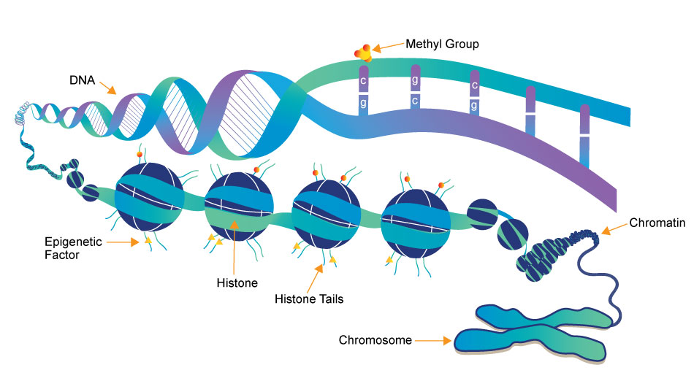
Cancer Epigenetics
Epigenetic mechanisms are essential for normal development and maintenance of tissue-specific gene expression patterns in mammals.
Disruption of epigenetic processes can lead to malignant cellular transformation which leads to cancer.

Slide 17
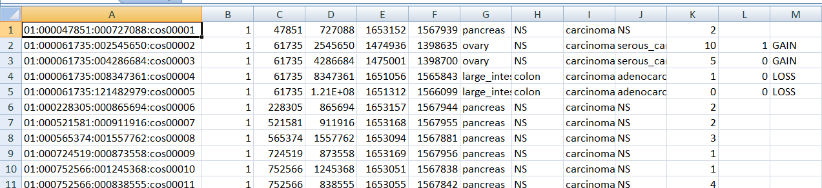
Database Pre-processing
Format Of Rowkey
chromosome:start:end:database tag
example: 01:000000001:000088452:cnv00497
So we delimited the columns and gave the zeros.

Slide 18
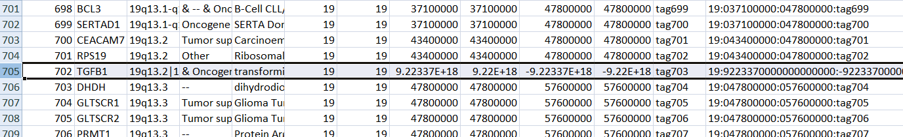
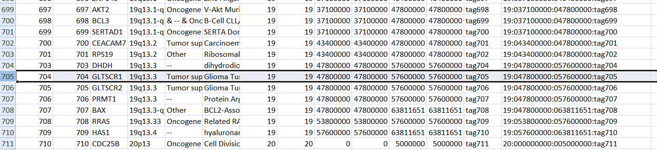
Removed records having infinite values

Slide 19
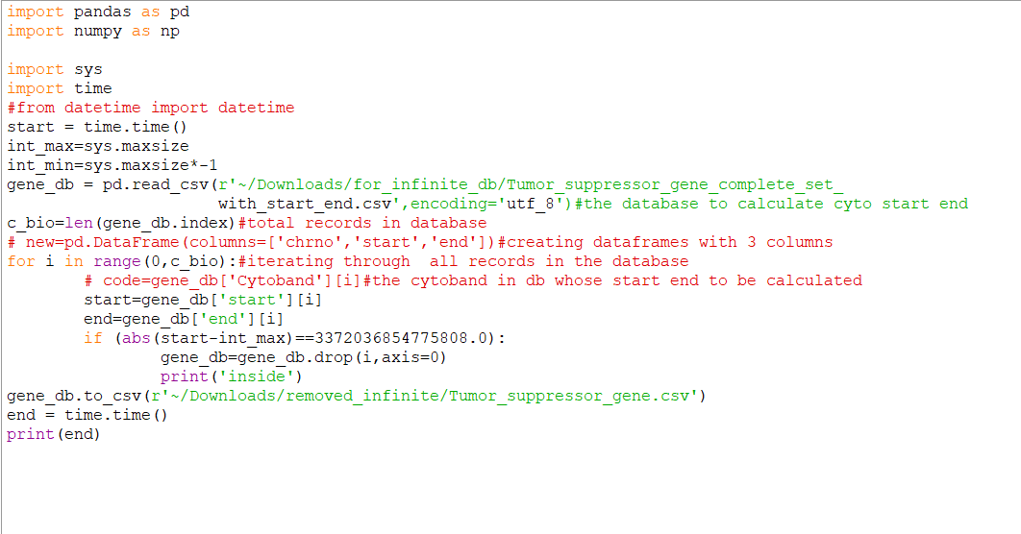
Code

Slide 20
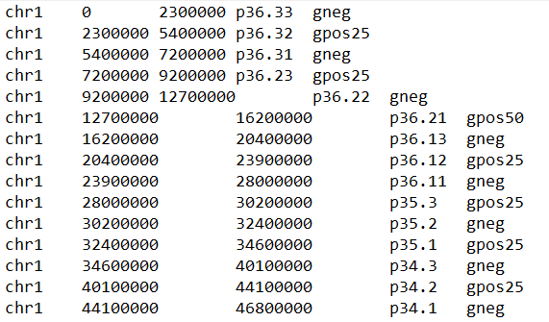
How to change cytoband to
our rowkey ??
We mapped all the chromosome, start, end values according to their cytoband.
We did it using a file cytoband.txt
Cytoband.txt file

Slide 21
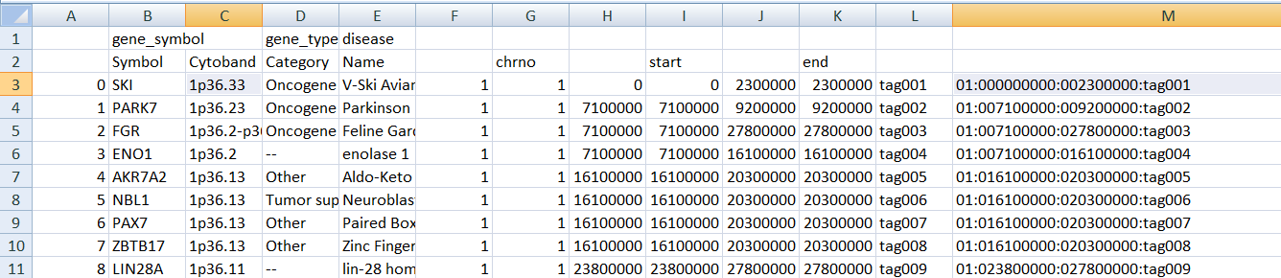
Transformed Cytoband To Chr : Start : End

Slide 22
Database Insertion
step 1 : copying the db
cp ~/Documents/database.csv .
Step 2 : moving it to hbase
hadoop fs -copyFromLocal database.csv /hbase
step 3 : Inserting it to hbase using a mapreduce command
hbase org.apache.hadoop.hbase.mapreduce.ImportTsv -Dimporttsv.separator=',' -Dimporttsv.columns=’HBASE_ROW_KEY,'column_family':'column'.......

Slide 23
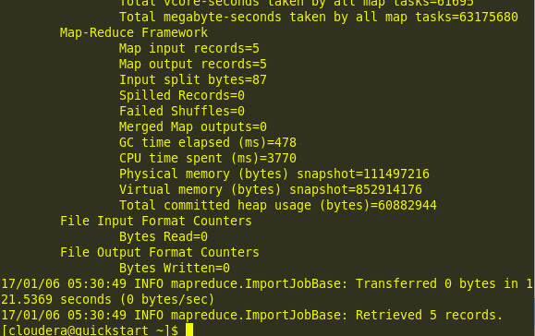
Inserted In table

Slide 24
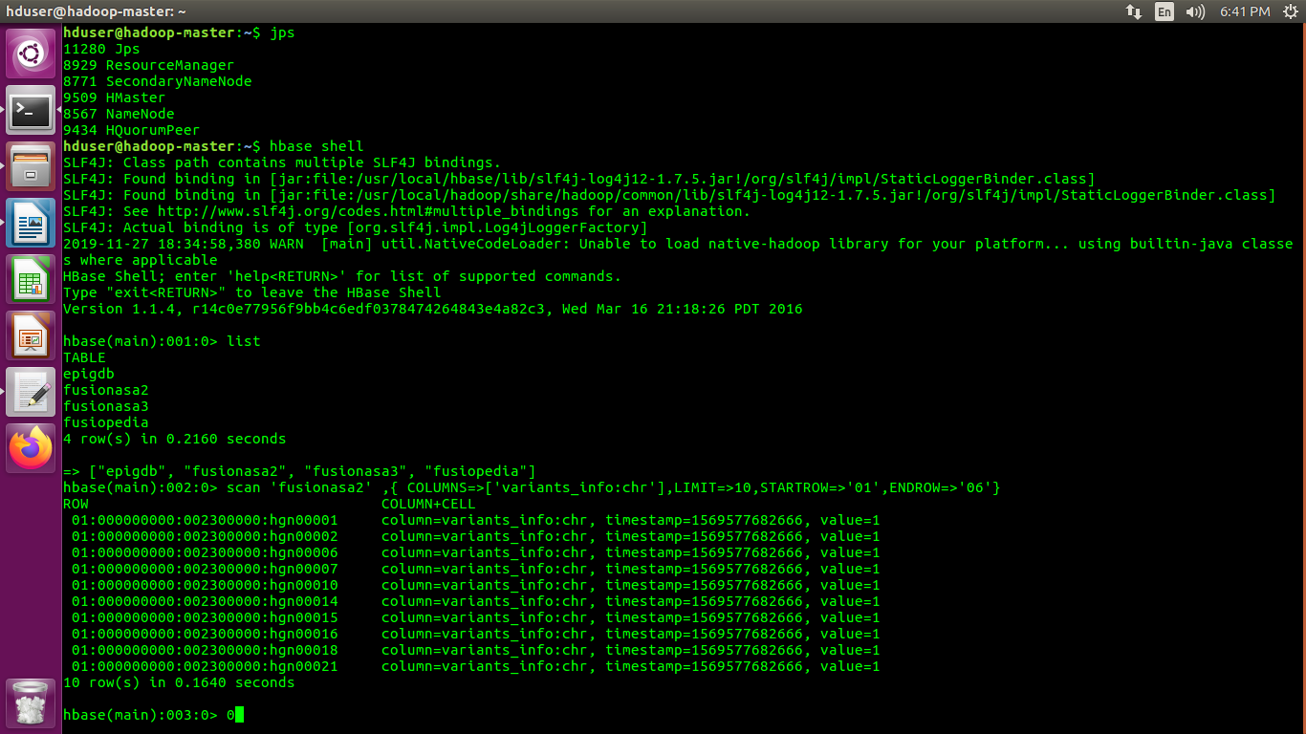
Hbase Scanning

Slide 25
Table & Graph For Analysis
UNIQUE PRIMARY SITE (COSMIC)
Primary site | Total
breast | 3083
central_nervous_system | 910
cervix | 236
endometrium | 2226
haematopoietic_and_lymphoid_tissue | 1465
kidney | 1193
large_intestine | 10038
liver | 256
lung | 7597
NS | 167
ovary | 9162
pancreas | 28323
urinary_tract | 879
Grand Total | 65535

Slide 26
TOTAL UNIQUE GENE TYPE (HGNC)
GENE TYPE | Sum of COUNT
non-coding RNA | 4210
other | 1136
phenotype | 482
protein-coding gene | 18995
pseudogene | 13004
Grand Total | 37827

Slide 27
Web Interface Using Flask
Fetching the data from Hbase for one the search form-
Converting the fetched data which is in the form of dictionary to a html table using python and ginger template.
Converting the processed result to html table.

Slide 28
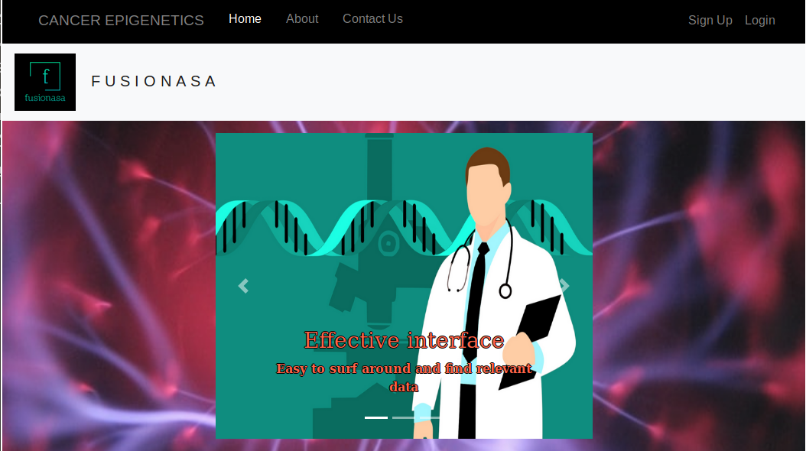
Homepage

Slide 29
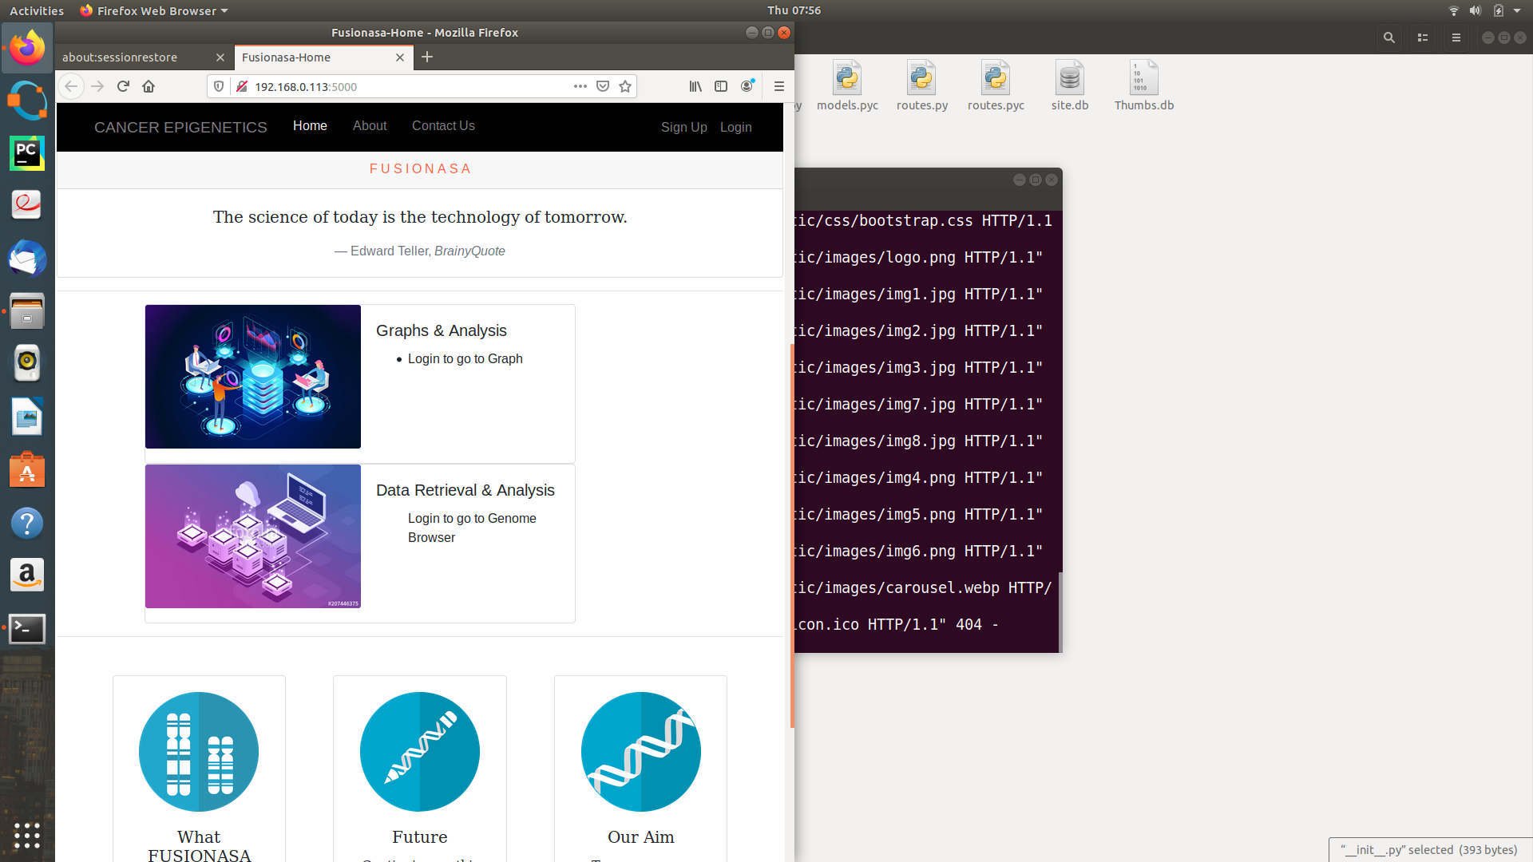
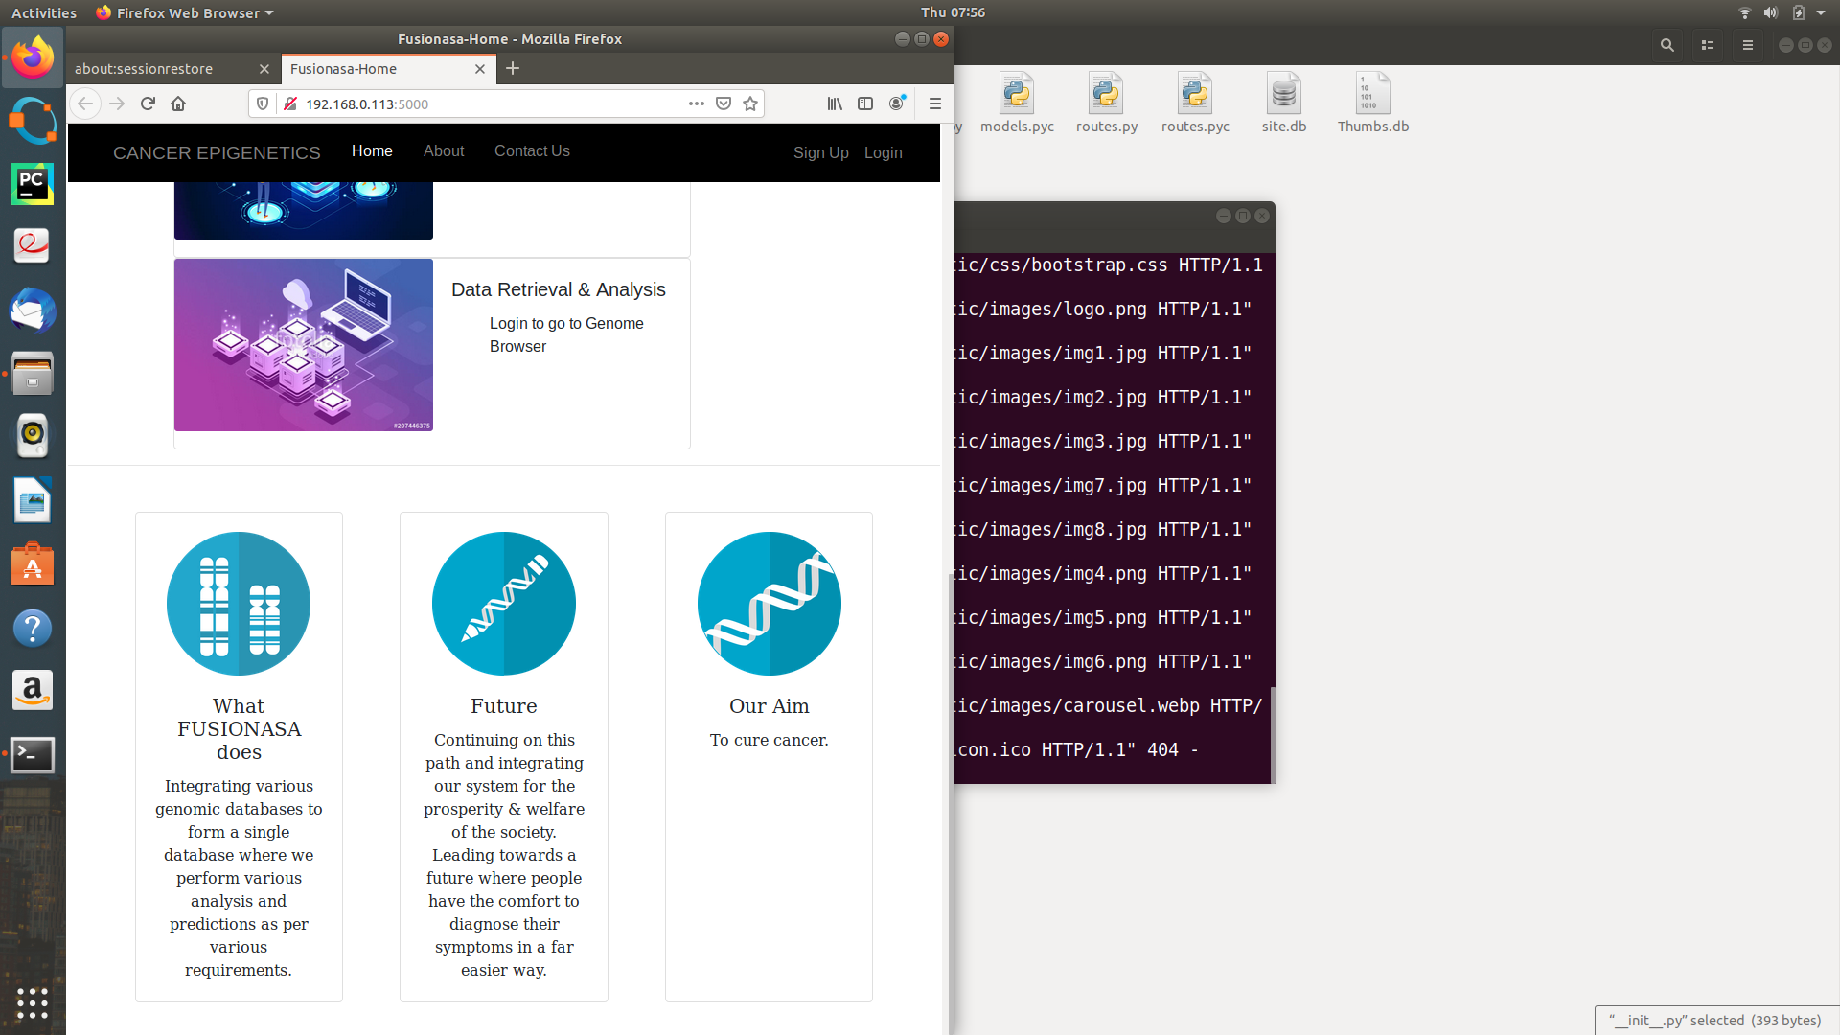
Homepage(continued..)

Slide 30
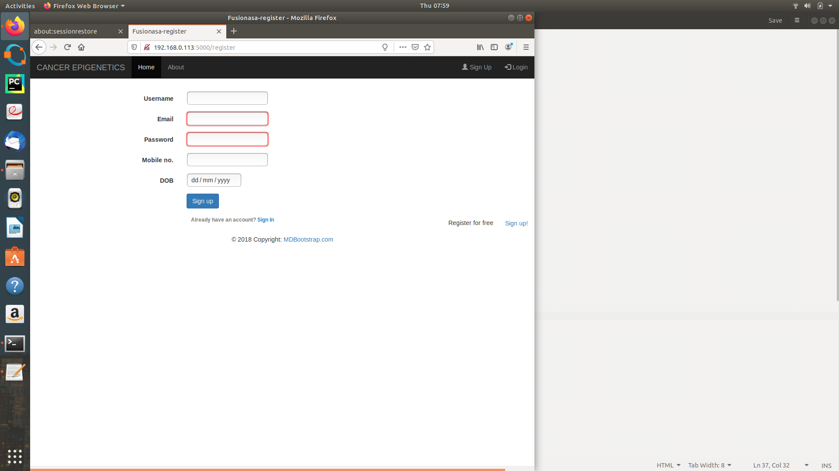
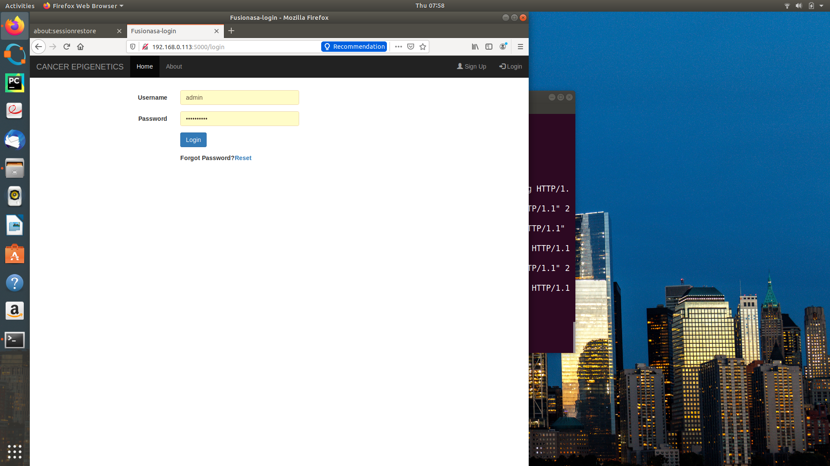
Register
Login

Slide 31
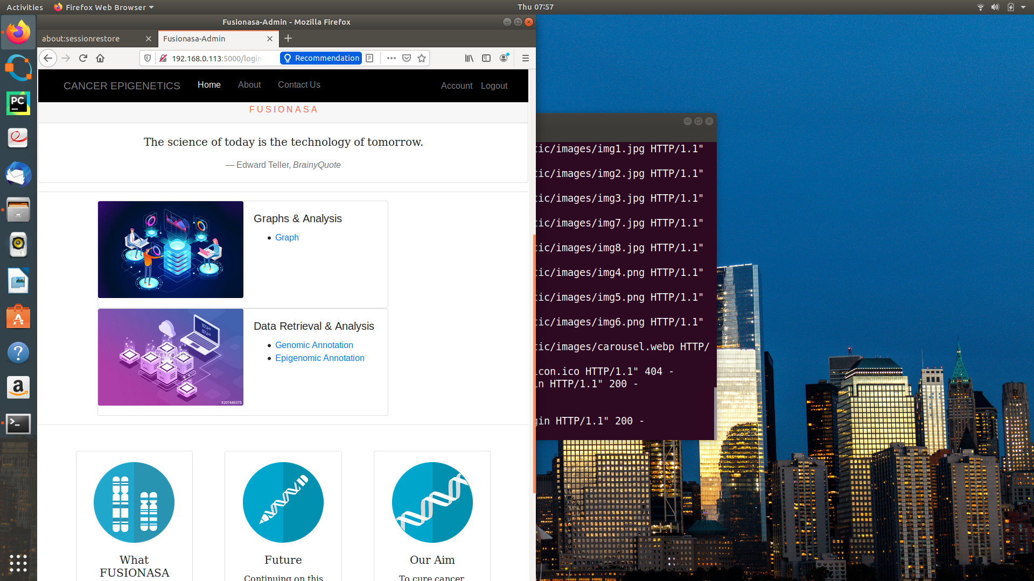
After Login

Slide 32
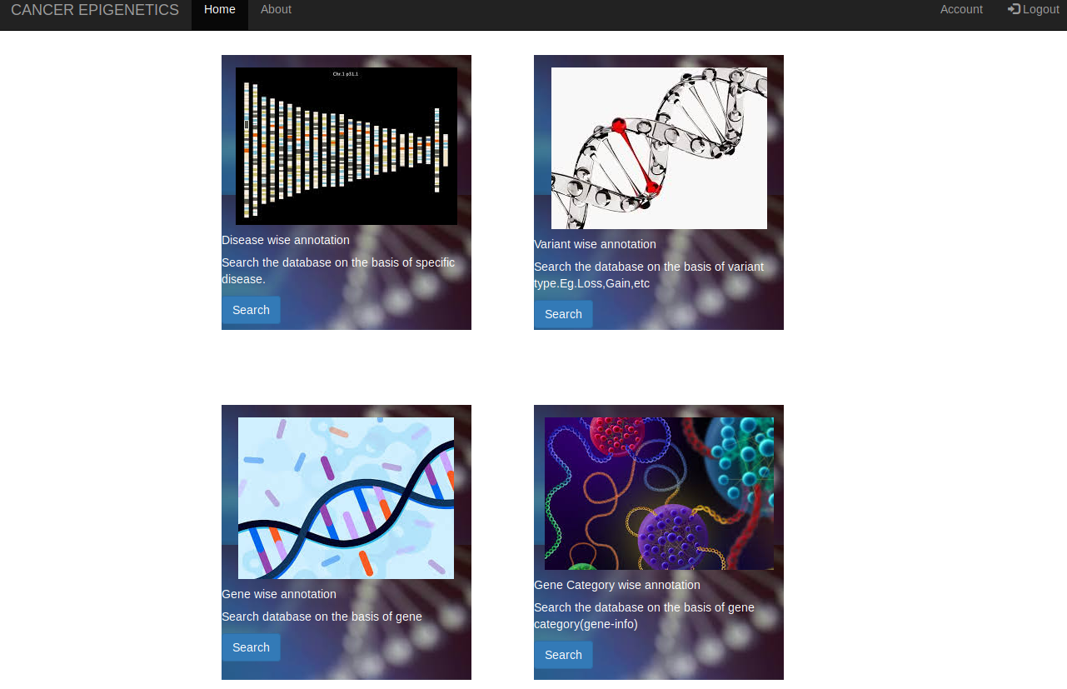
Genomic annotation

Slide 33
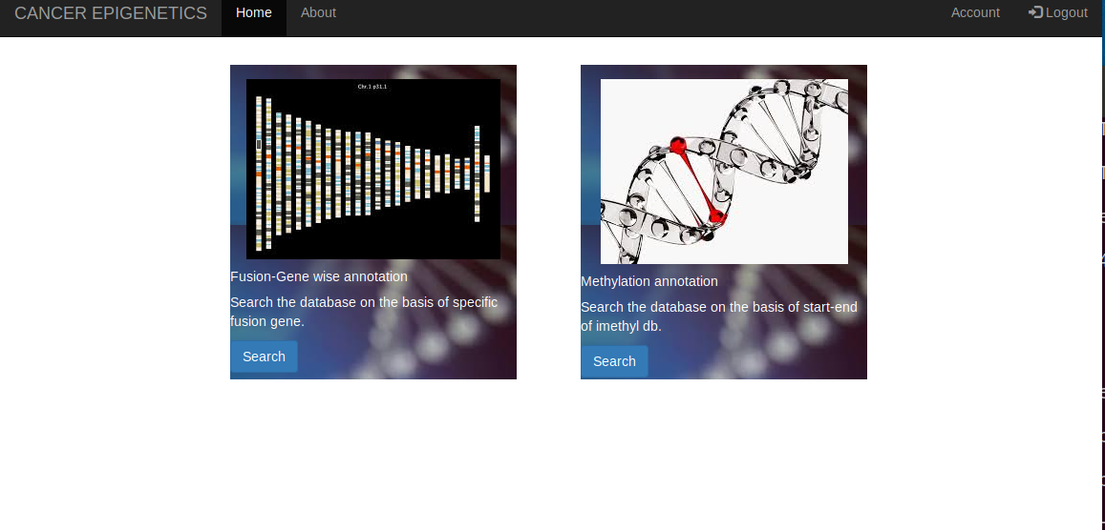
Epigenomic annotation

Slide 34
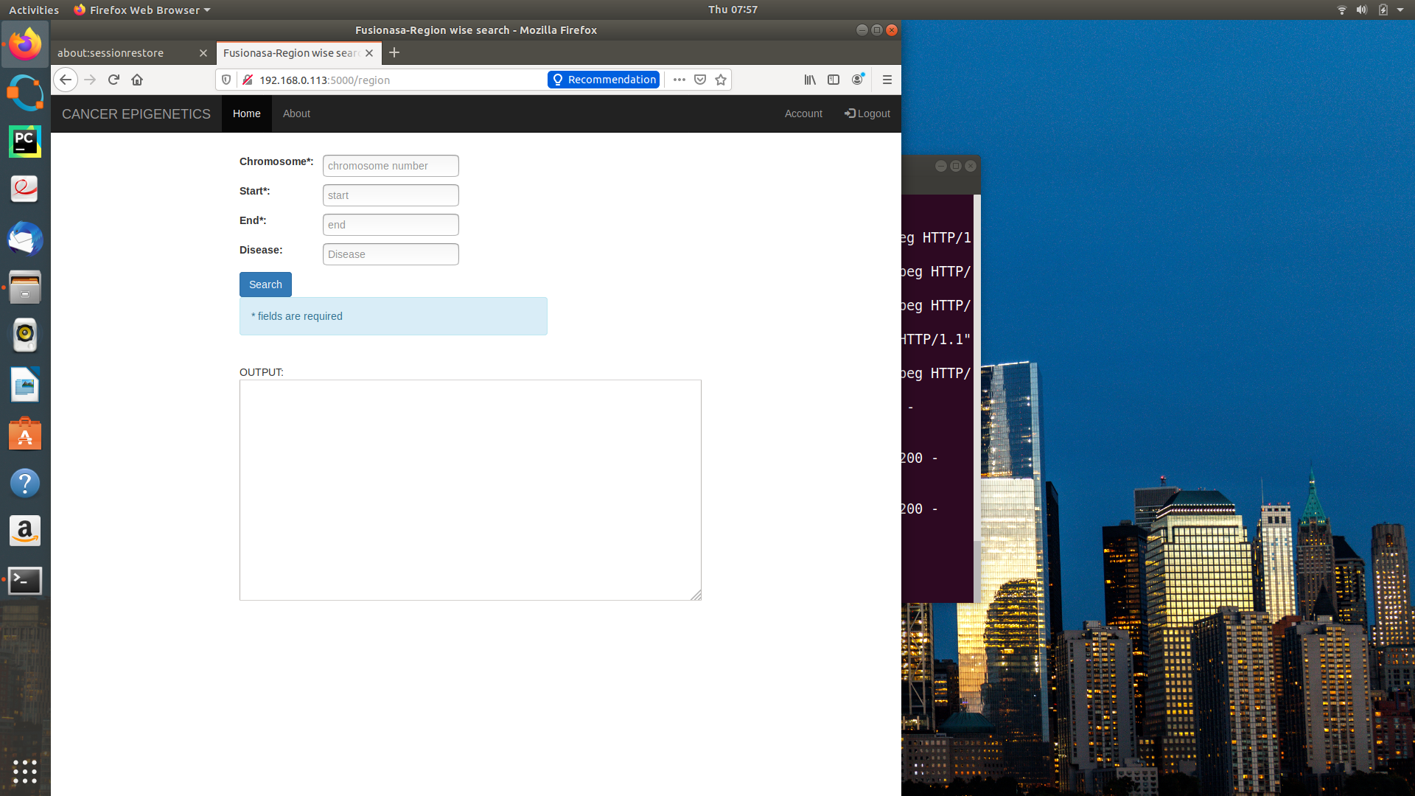
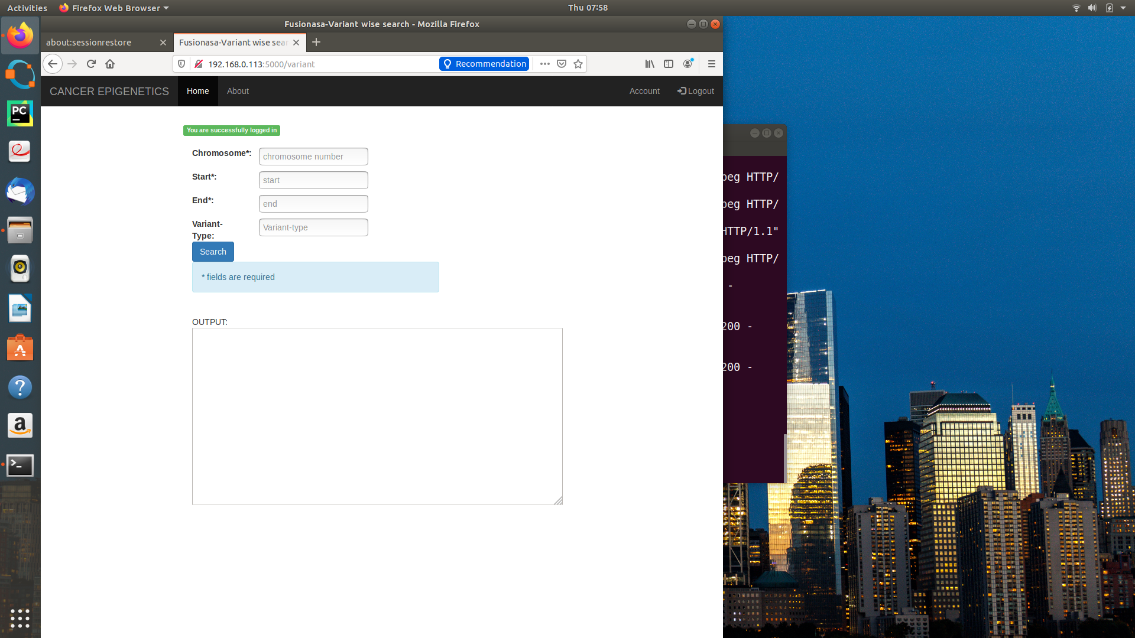
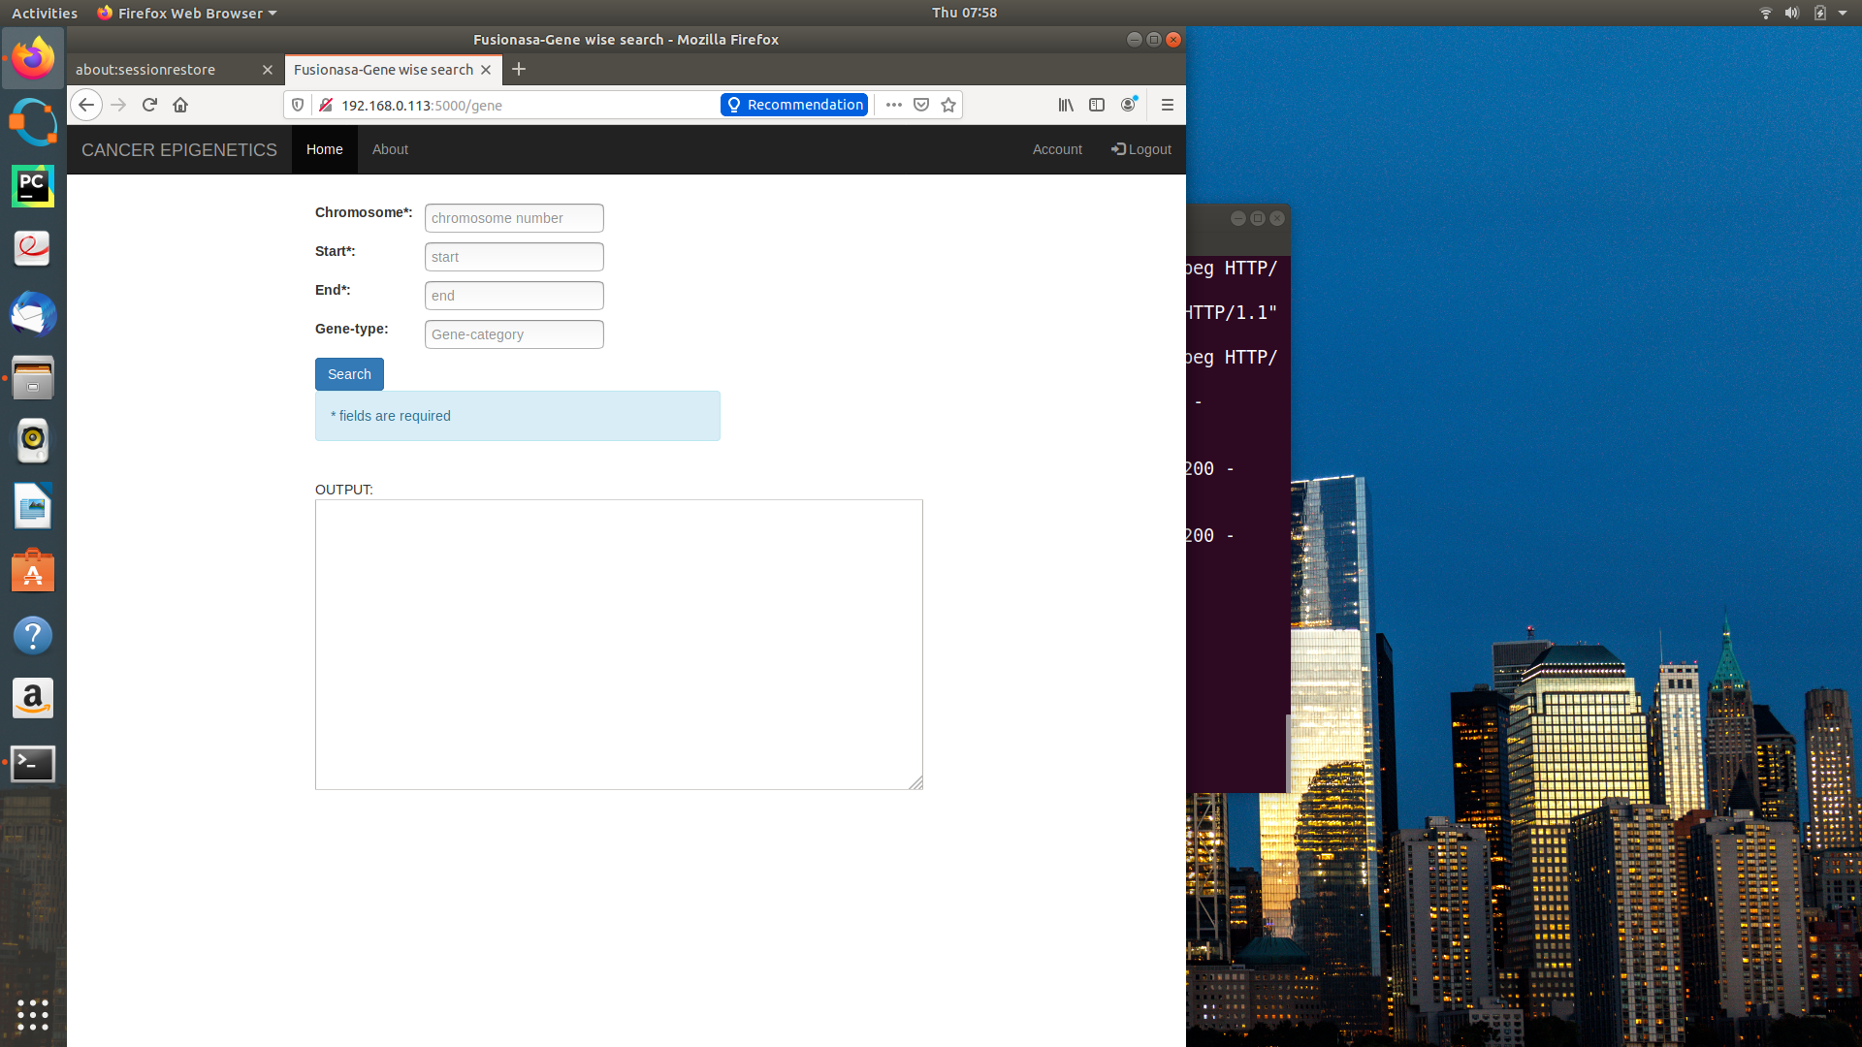
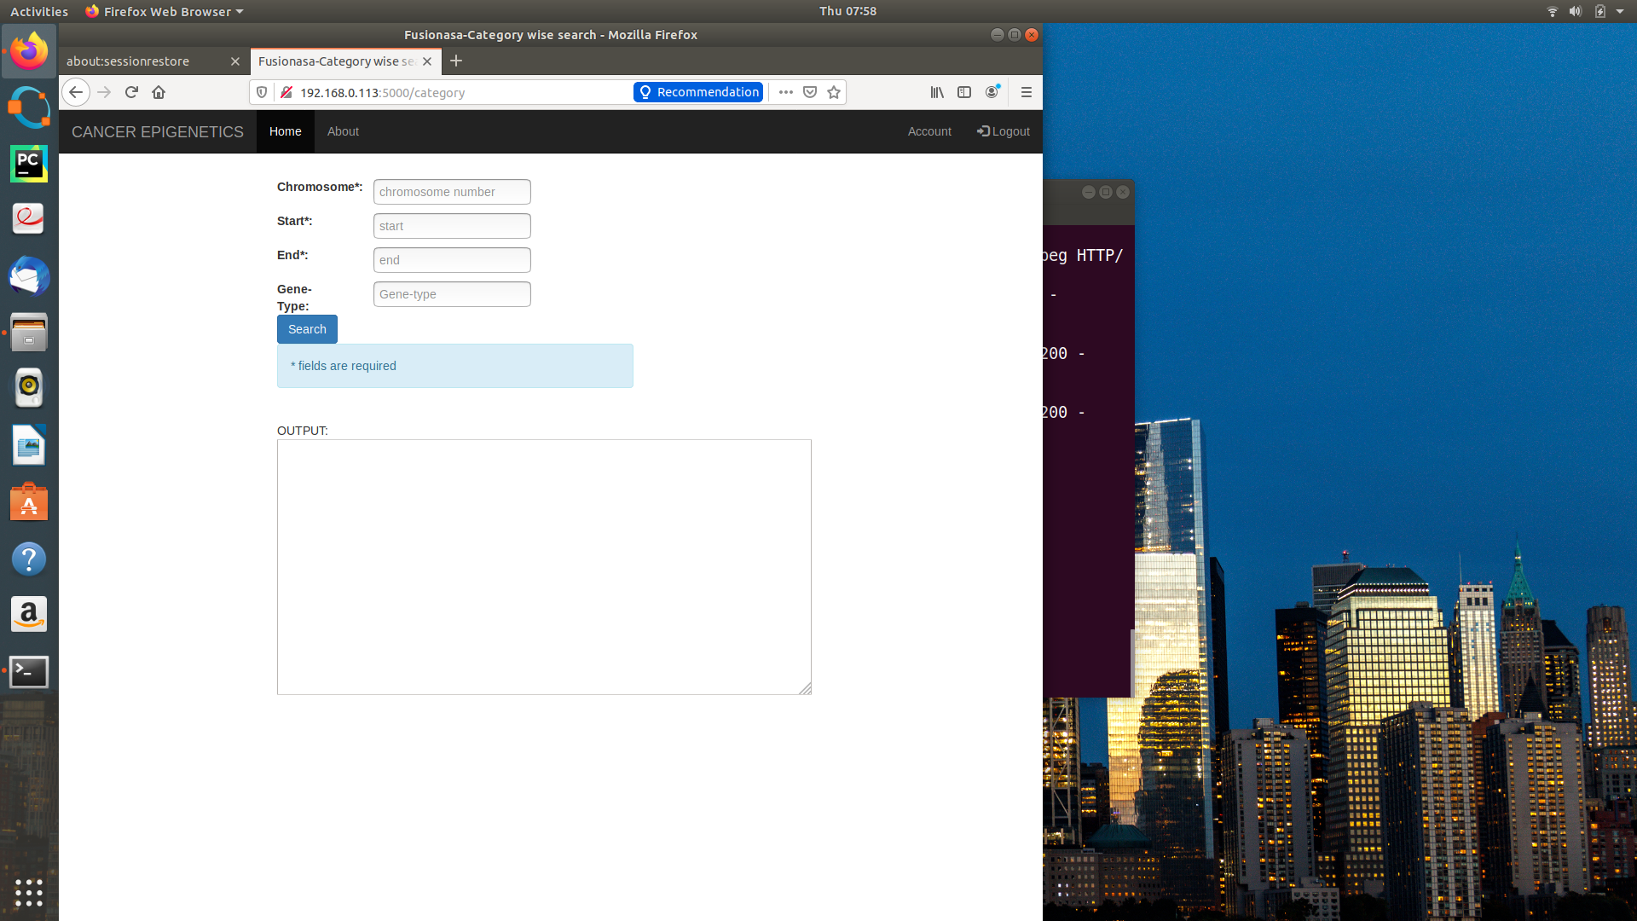
Genomic annotation
Disease-wise
Variant-wise
Category-wise
Gene-wise

Slide 35
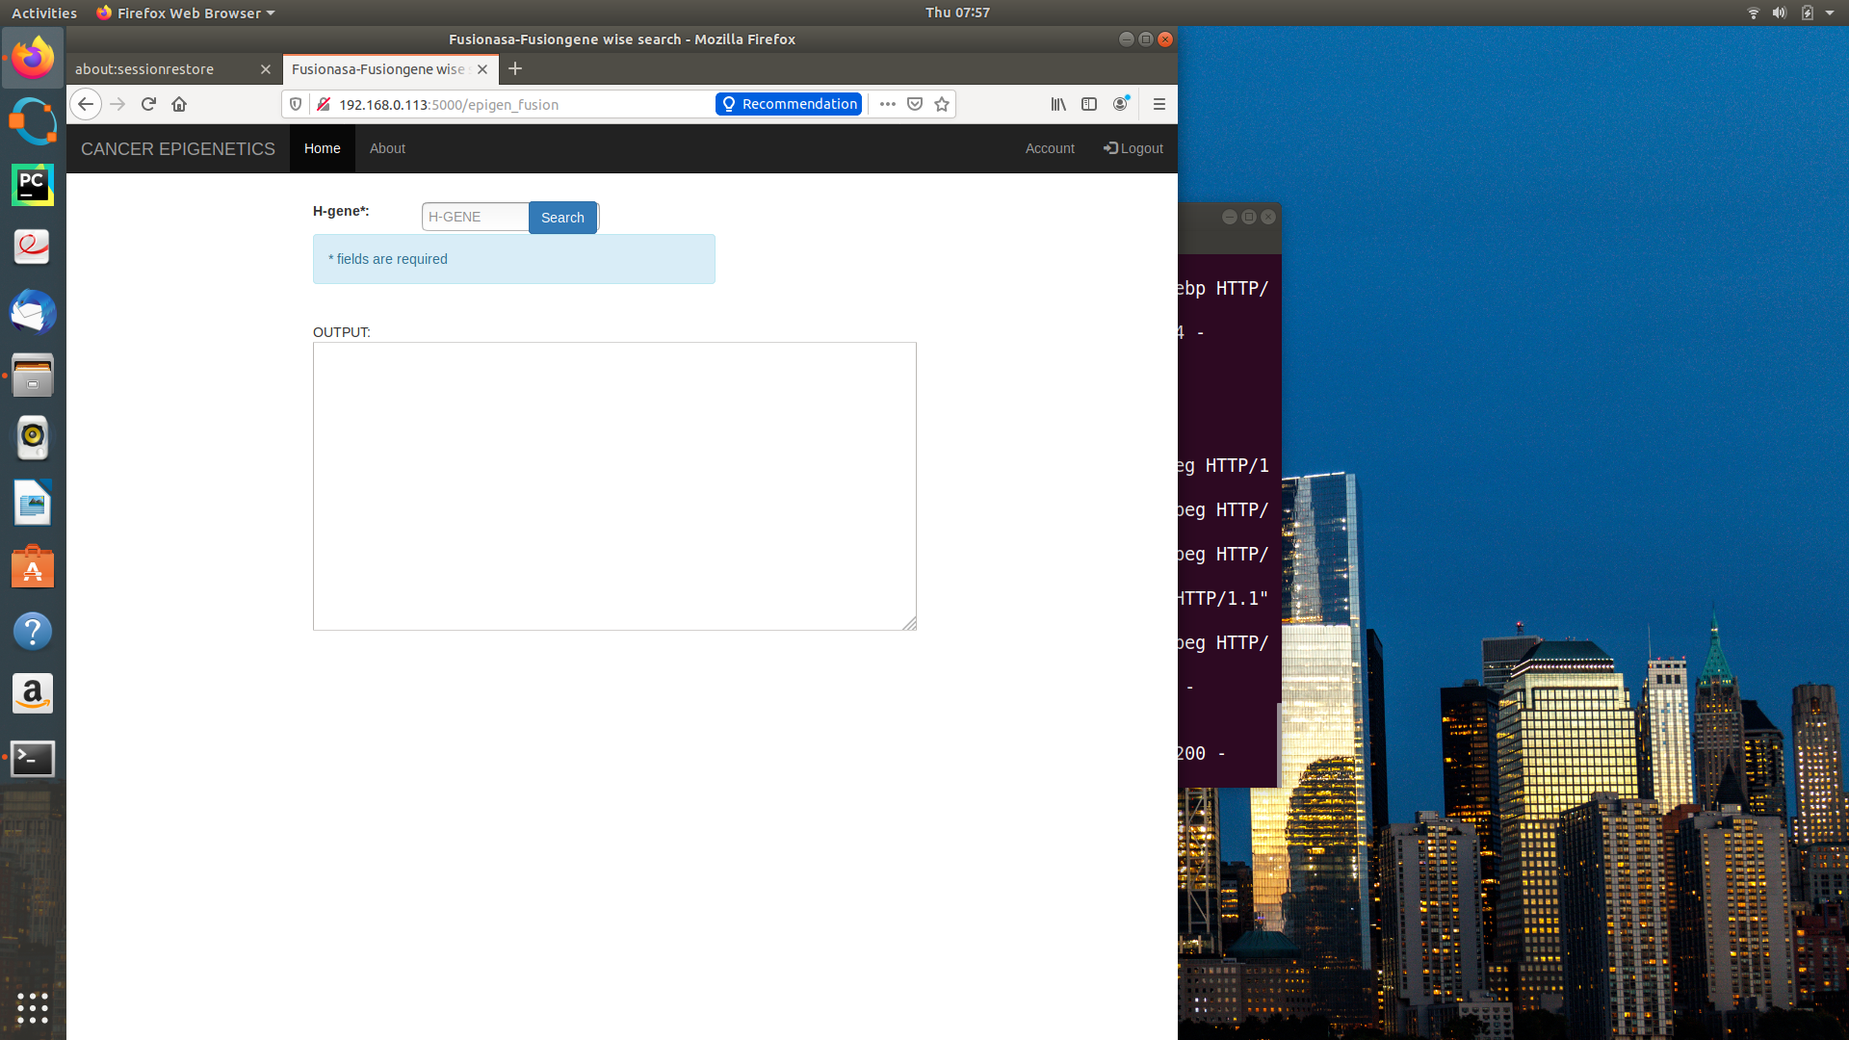
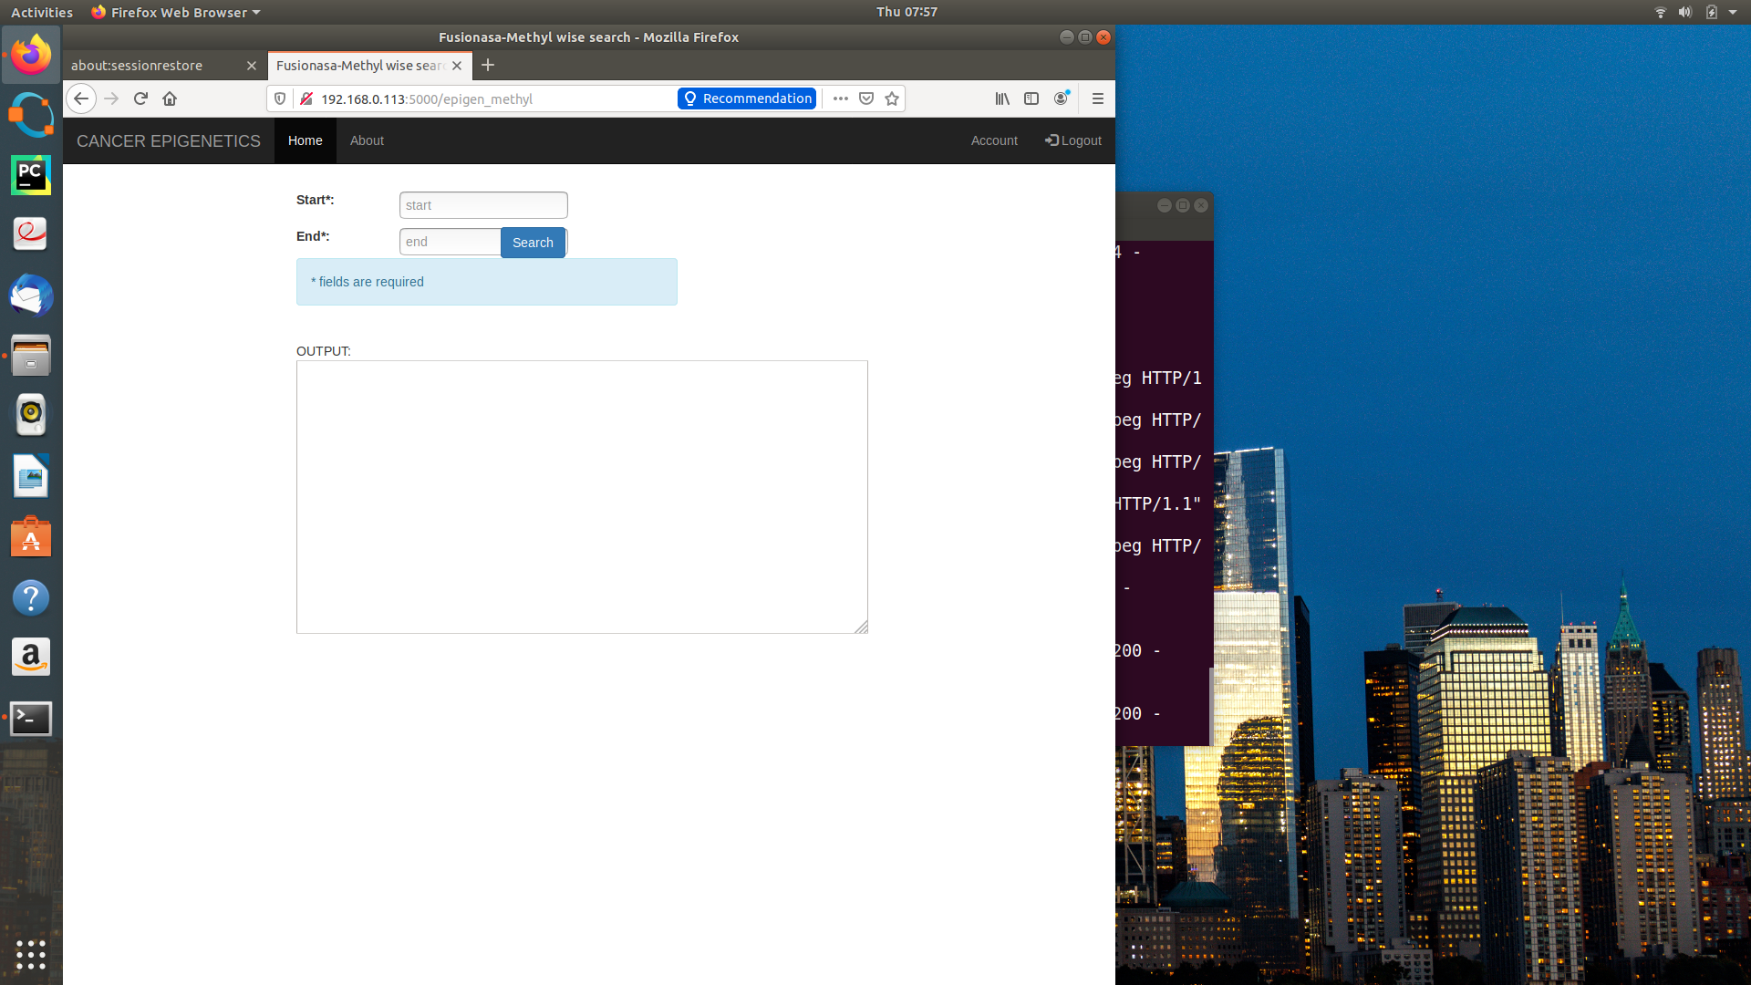
Epigenomic annotation
Fusion gene-wise
iMethyl-gene-wise

Slide 36
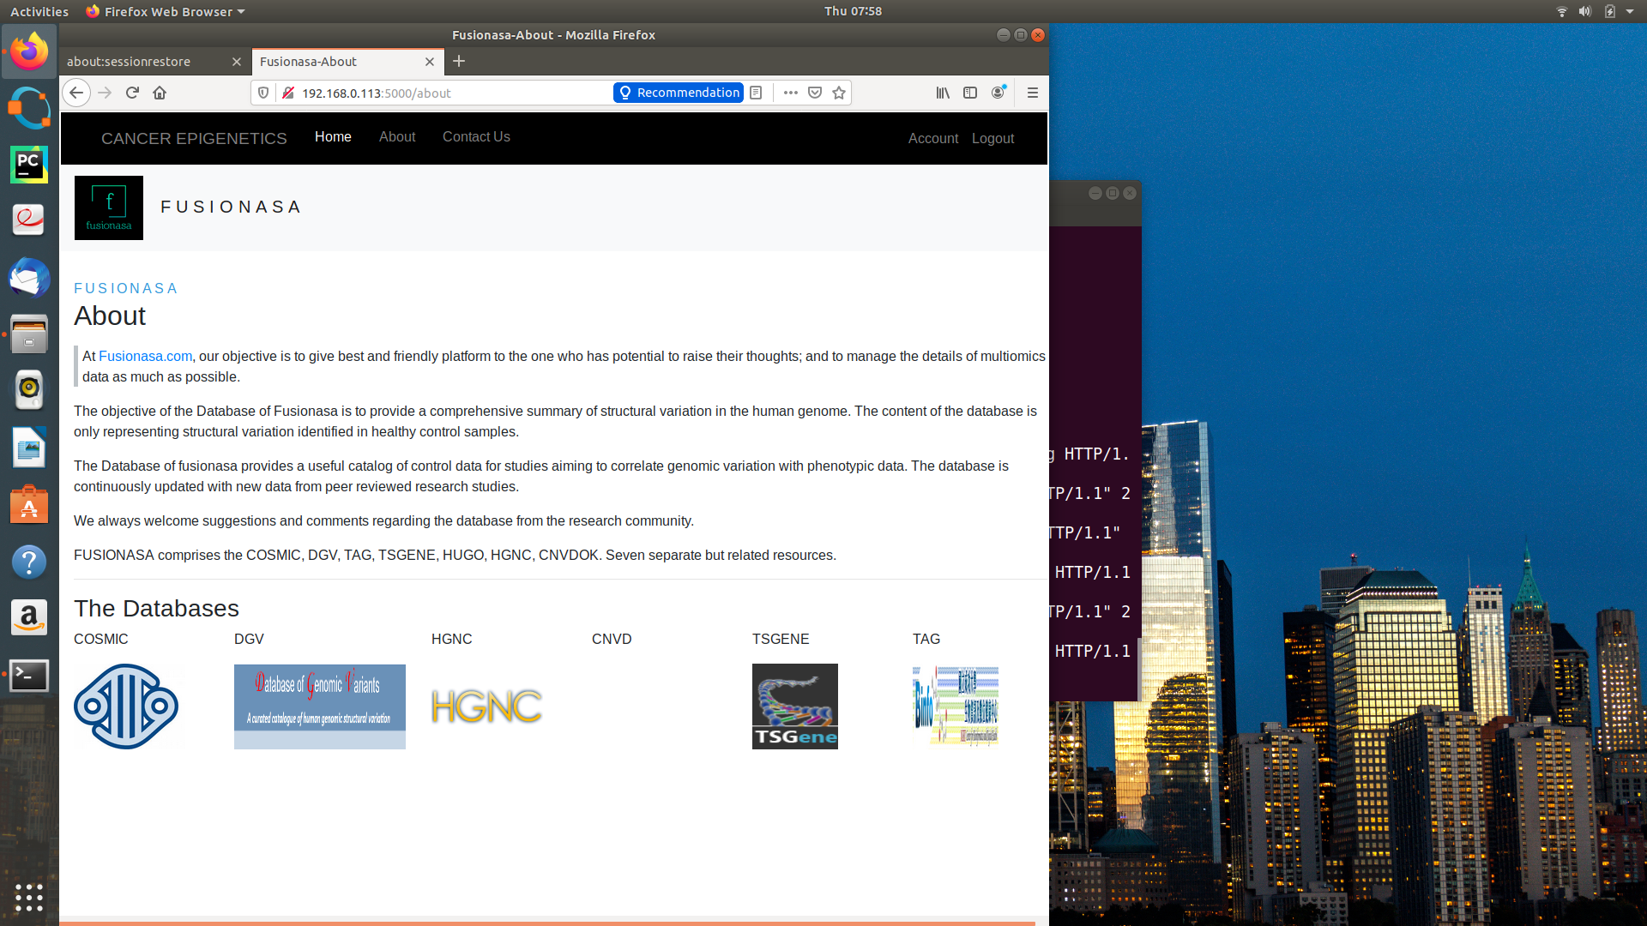
About

Slide 37
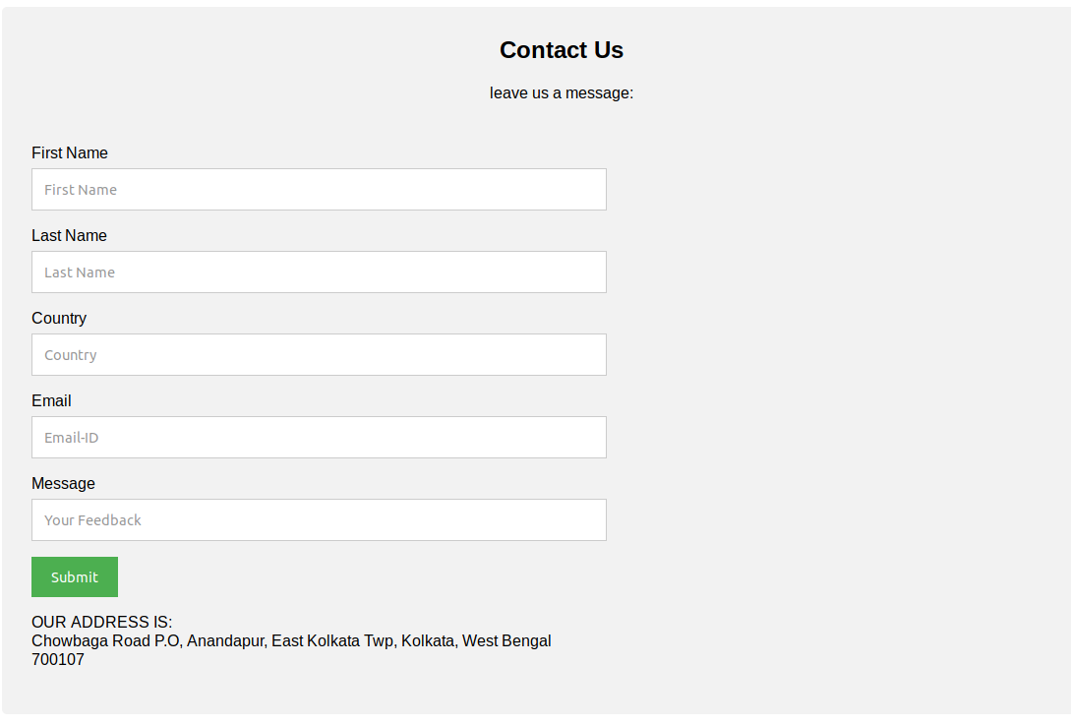
Contact

Slide 38
BACKEND

Slide 39
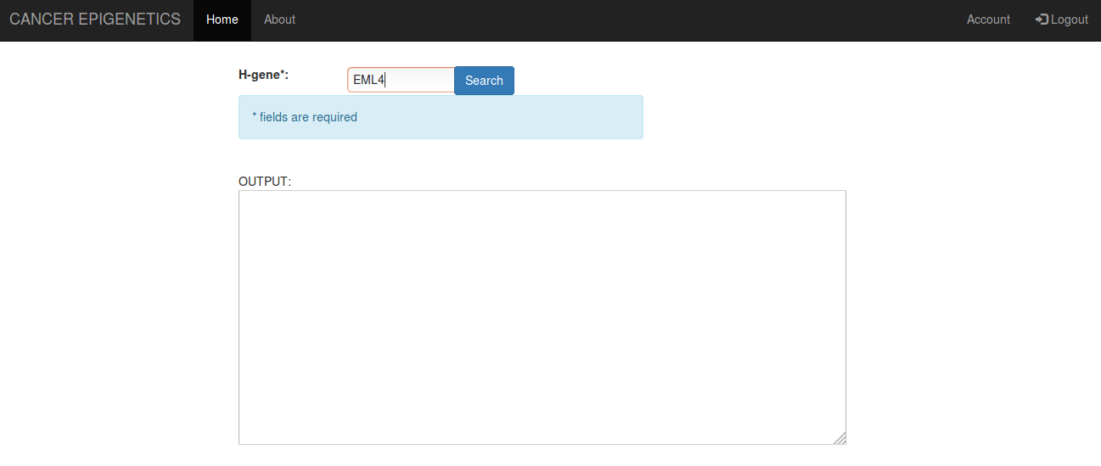
A.(i) Fetching the data from Hbase for one the search form-

Slide 40
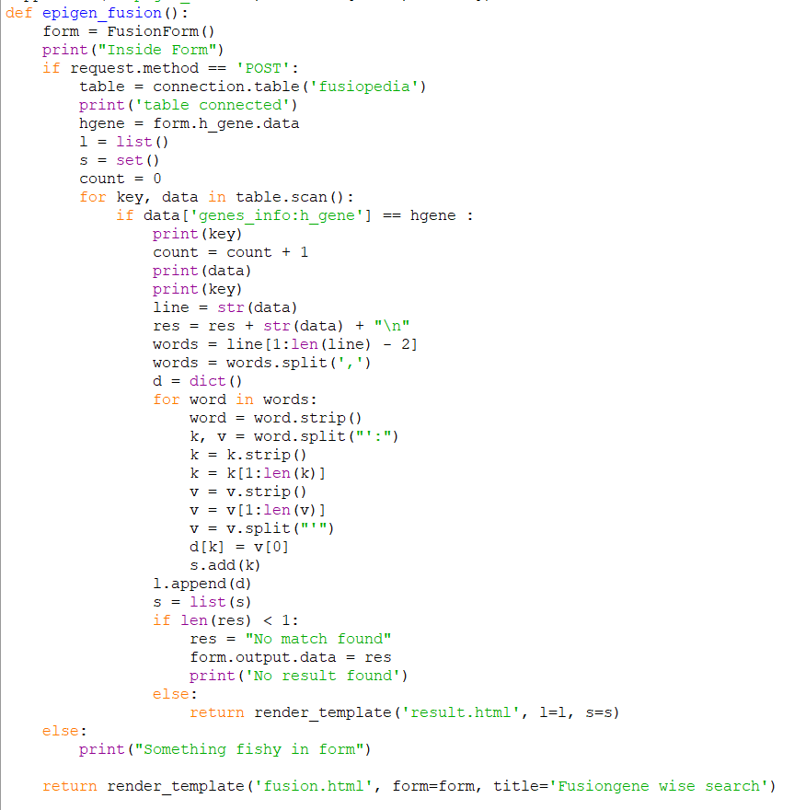
A.(ii) CODE-Fetching details from search form and processing and sending to next form for creating table

Slide 41
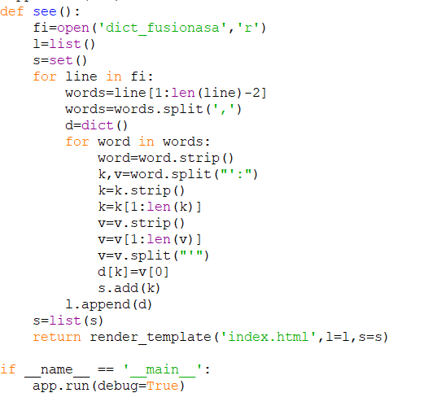
B. Converting the fetched data which is in the form of dictionary to a html table using python and ginger template.

Slide 42
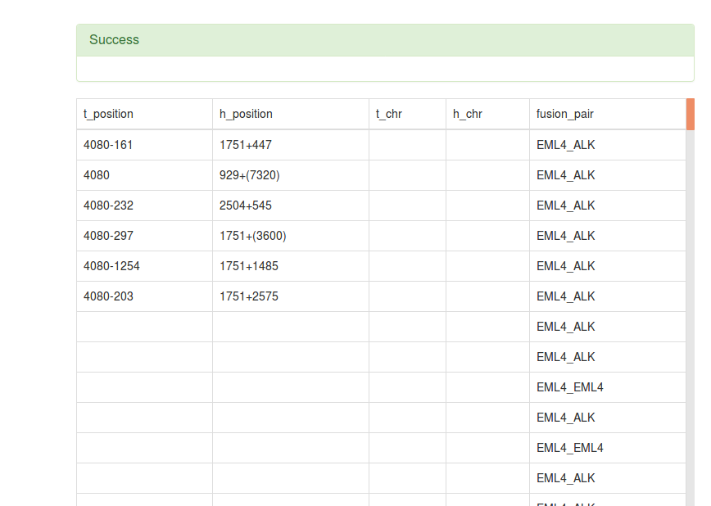
C. Converting the processed result to html table.
C(i). Result

Slide 43
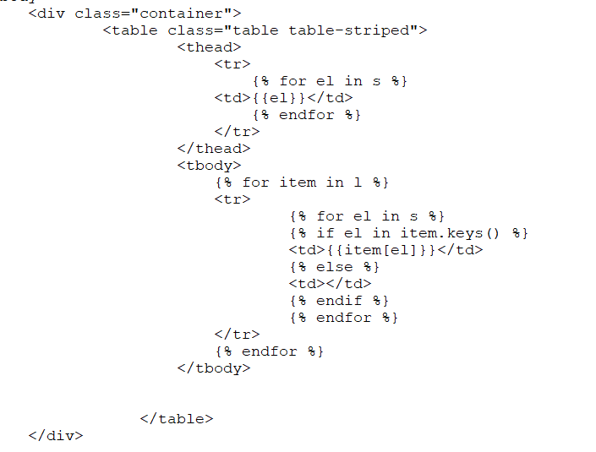
C(ii). Code

